Slide 1





Scaled Measurements of Realistic Counter-DEW Scenarios
EUOREM, London, UK
11 July 2016
Bo Xiao¹
Zach Drikas²
Jesus Gil Gil²
T. D. Andreadis²
Tom Antonsen¹
Ed Ott¹
Steven M. Anlage¹
¹ University of Maryland, USA
² US Naval Research Laboratory
Random Coupling Model website:
http://anlage.umd.edu/RCM
Research funded by ONR
ONR/DURIP
AFOSR / AFRL Center of Excellence
Notes:
30 minutes including questions.

Slide 2
Outline
The Problem: Electromagnetic Interference
Our Approach – A Wave Chaos Statistical Description
The Random Coupling Model (RCM)
Example of the RCM in Practice
New RCM Predictions for Realistic Counter-DEW Scenarios
Scaled measurement system for investigating new RCM predictions
Conclusions

Slide 3
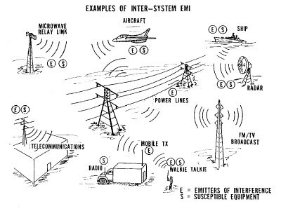
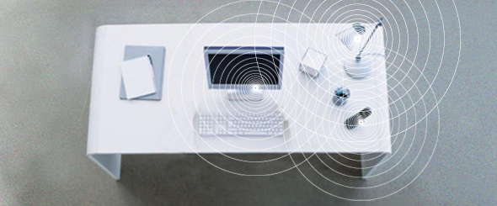
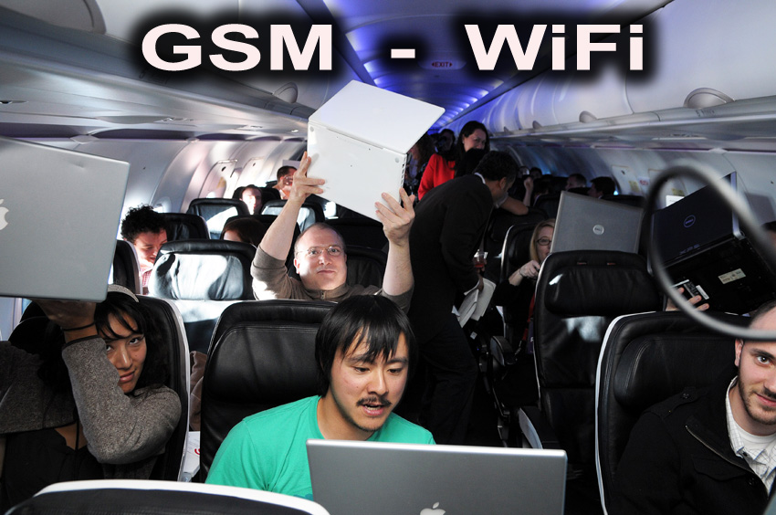
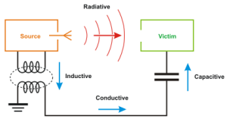
Electromagnetic Interference and
High-Power Microwave Effects on Electronics
How to defend electronics from electromagnetic interference?
R.F.I. International
Electromagnetic Interference (EMI)
Electromagnetic Compatibility (EMC)

Slide 4
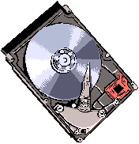
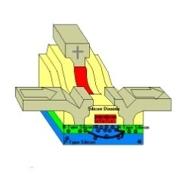
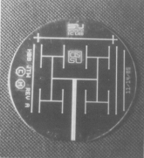
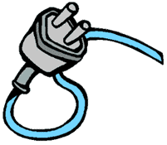

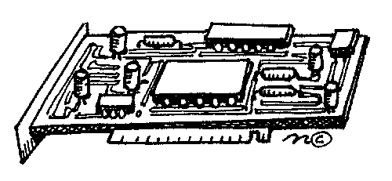
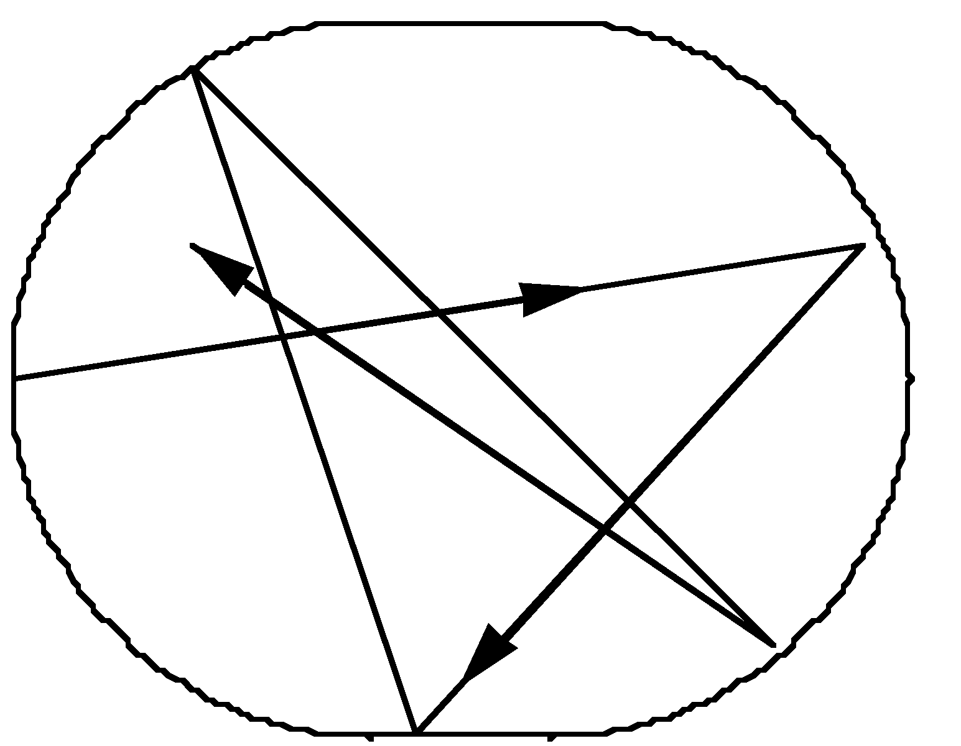
Electromagnetic Coupling to Enclosures and Circuits A Complicated Problem
Arbitrary Enclosure
(with losses “1/Q”)
Coupling of external radiation to computer chips is a complex process:
  Apertures
  Resonant cavities
  Transmission Lines
  Circuit Elements
System Size >> Wavelength
What can we say about the nature of fields and induced voltages inside such a cavity?
Chaotic Ray
Trajectories
Statistical Description using Wave Chaos!!
Rather than make predictions for a specific configuration,
determine a probability distribution function (PDF) of the
relevant quantities

Slide 5
Outline
The Problem: Electromagnetic Interference
Our Approach – A Wave Chaos Statistical Description
The Random Coupling Model (RCM)
Example of the RCM in Practice
New RCM Predictions for Realistic Counter-DEW Scenarios
Scaled measurement system for investigating new RCM predictions
Conclusions

Slide 6
The Difficulty in Making Predictions in Wave Chaotic Systems…
Perturbation Position 1
The extreme sensitivity of the properties of
wave chaotic systems to small perturbations
suggests a statistical approach
Ray-
Chaotic
Enclosure
(Ω)
Perturbation Position 2
The Random Coupling Model incorporates the
underlying chaos into a quantitative statistical
description of the wave properties of real systems
Electromagnetic
Wave Impedance

Slide 7
Induced Voltage Statistical Distributions
for Objects in an Arbitrary Enclosure
Port 5
Arbitrary Enclosure
(with losses “1/Q”)
Port 1
Port j
Generalized Port
Concept
Port i
Port 4
Port 3
Port 2
Our approach treats all objects of interest as “ports”
Incident rf energy enters the enclosure through one or more ports
The energy reverberates and is absorbed by one or more ports inside the enclosure
Formulate a quantitative statistical theory of absorbed energy

Slide 8
Outline
The Problem: Electromagnetic Interference
Our Approach – A Wave Chaos Statistical Description
The Random Coupling Model (RCM)
Example of the RCM in Practice
New RCM Predictions for Realistic Counter-DEW Scenarios
Scaled measurement system for investigating new RCM predictions
Conclusions

Slide 9
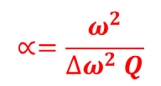
Statistical Model of Impedance (Z) Matrix
S. Hemmady, et al., Phys. Rev. Lett. 94, 014102 (2005)
L. K. Warne, et al., IEEE Trans. on Anten. and Prop. 51, 978 (2003)
X. Zheng, et al., Electromagnetics 26, 3 (2006); Electromagnetics 26, 37 (2006)
Enclosure
Statistical Model Impedance
Port 1
Losses
w_{in} w_{jn}
Other ports
modes n
R_{R1}(ω)
Radiation Resistance R_{Ri}(ω)
Port 2
System
parameters
Δω²_{n} - mean spectral spacing
R_{R2}(ω)
Q -quality factor
Port 1
Statistical
parameters
ω_{n} - random spectrum (RMT)
Free-space radiation
Resistance R_{R}(ω)
Z_{R}(ω) = R_{R}(ω) + jX_{R} (ω)
w_{in}- Guassian Random variables
$$∝=\frac{ω^{2}}{∆ω^{2} Q}$$
Statistics governed by a single parameter:

Slide 10
Outline
The Problem: Electromagnetic Interference
Our Approach – A Wave Chaos Statistical Description
The Random Coupling Model (RCM)
Example of the RCM in Practice
New RCM Predictions for Realistic Counter-DEW Scenarios
Scaled measurement system for investigating new RCM predictions
Conclusions

Slide 11
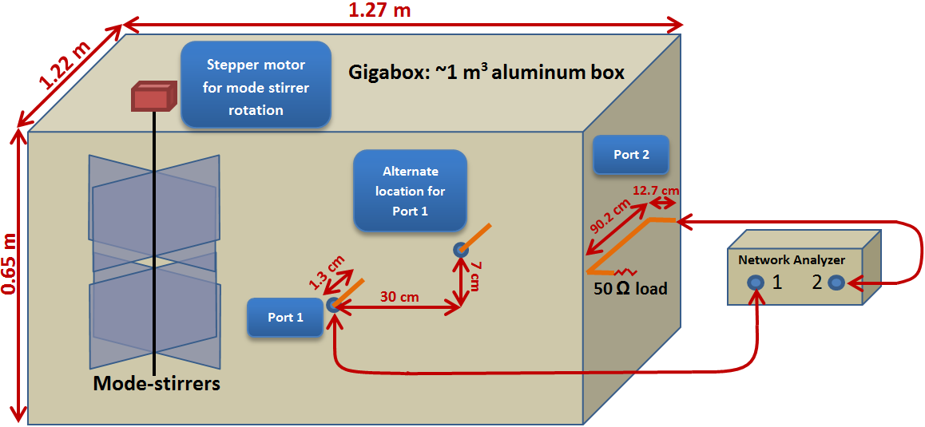
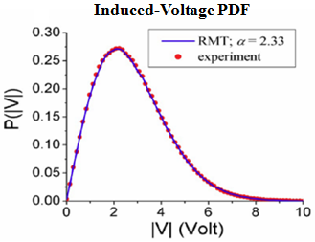
Test of the Random Coupling Model: Gigabox Experiment (NRL Collaboration)
Inject microwaves at port 1 and measure induced voltage at port 2
Rotate mode-stirrer and repeat
Plot the PDF of the induced voltage and compare with RCM prediction
But this is at the limit of what we can test in our labs …
Z. B. Drikas, et al., IEEE EMC 56, 1480 (2014)
US Naval Research Laboratory collaboration

Slide 12
Outline
The Problem: Electromagnetic Interference
Our Approach – A Wave Chaos Statistical Description
The Random Coupling Model (RCM)
Example of the RCM in Practice
New RCM Predictions for Realistic Counter-DEW Scenarios
Scaled measurement system for investigating new RCM predictions
Conclusions

Slide 13
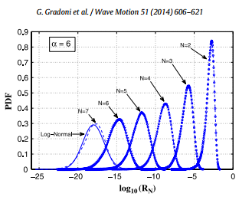
Coupled Lossy Cavities
RCM predicts the transmission through N cavities coupled through apertures
Experiment requires a chain of Gigaboxes
Ability to predict coupled voltage and power along an arbitrary chain of
ray-chaotic cavities/environments/compartments
G. Gradoni, T. M. Antonsen, and E. Ott,
Phys. Rev. E 86, 046204 (2012).

Slide 14

Untested RCM Prediction: Induced Voltage Statistics for Enclosures with Mixed
Regular and Chaotic Behavior
Random Coupling Model still works!
$$Z_{ij}=Z_{ij, Regular}+Z_{ij,Chaotic}$$
Ming Jer Lee, et al., Phys. Rev. E 87, 062906 (2013)

Slide 15
Outline
The Problem: Electromagnetic Interference
Our Approach – A Wave Chaos Statistical Description
The Random Coupling Model (RCM)
Example of the RCM in Practice
New RCM Predictions for Realistic Counter-DEW Scenarios
Scaled measurement system for investigating new RCM predictions
Conclusions

Slide 16

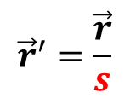

Scaling Properties of Maxwell’s Equations for Harmonic EM waves
Maxwell’s equations are left invariant upon scaling:
$${\vec{r}}^{′}=\frac{\vec{r}}{s}$$
$$ω′=sω$$
$$σ′=sσ$$
For example, scaling the GigaBox down by a factor of s = 20 requires:
1 m x 1 m x 1 m Box
5 cm x 5 cm x 5 cm Box
5 GHz measurement
100 GHz measurement
Wall conductivity σ
Wall conductivity s*σ

Slide 17
Overview of the Scaled Measurement Project
Test the Random Coupling Model in a set of increasingly complicated
(and realistic) scenarios:
Multiple coupled cavities
Mixed (regular + chaotic) systems
Irradiation through irregular apertures
Evanescent coupling between enclosures
etc.
Perform these tests using scaled-down-in-size models:
To reproduce the same electromagnetic conditions:
Must scale up the frequency to mm-waves
Must scale up the conductivity (cool the metal walls)
ONR/DURIP-funded mm-wave cryogenic measurement system
Validation step: compare to full-scale measurement at NRL

Slide 18
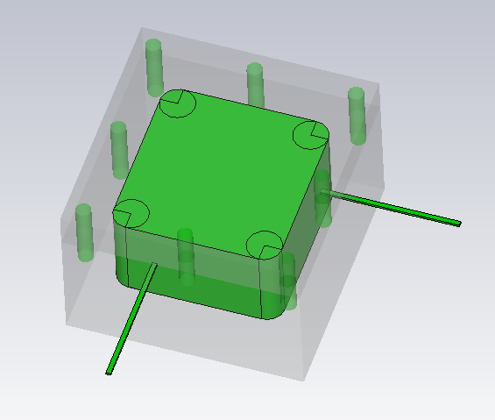
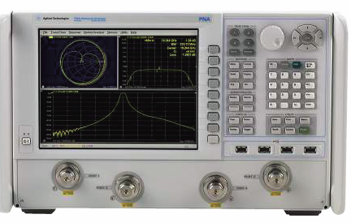
Scaled Structure
Horn antenna
WR10 75-110 GHz
WR3.4 220-330 GHz
Frequency Extender
mm-wave
Teflon lens
Inside cryostat
ONR/DURIP funded experiment setup
windows
mm-wave
Coax ~10 GHz
Reference plane
Frequency Extender
Coax ~10 GHz

Slide 19
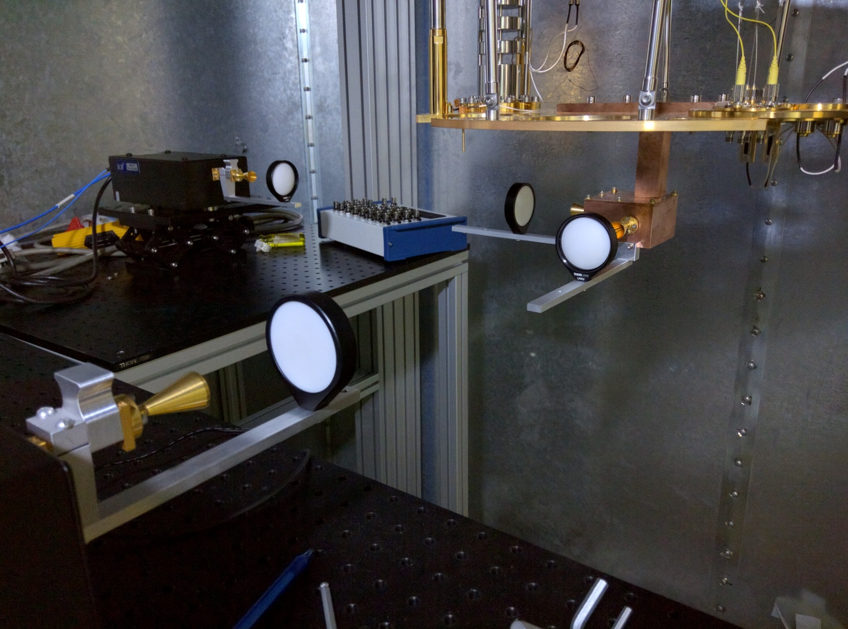
Experimental Setup
Receiver
Scaled Structure
mm-wave
Transmitter

Slide 20
Scaled Enclosures (s = 20 and 40)

Slide 21
Scaled Enclosure Measurement Validation: Compare to NRL Full-Scale Experimental Setup
127.5 cm
b
a = 27.9 cm
Stirrer (Motor Controlled)
a
b = 27.5 cm
2.1 cm
25 cm
Port 2
25 cm
66 cm
Port 1
25 cm
c
2.5 cm
c
122.5 cm
c
c = 25 cm
30.5 cm
We will measure two scaled versions:
75 GHz – 110 GHz (s = 20) → 3.7 GHz – 5.5 GHz
44.5 cm
WR-187 (G-Band)
220 GHz – 330 GHz (s = 40) → 5.5 GHz – 8.25 GHz
90˚
WR-137 (C-Band)
Zach Drikas, Jesus Gil Gil, T. D. Andreadis @ NRL

Slide 22
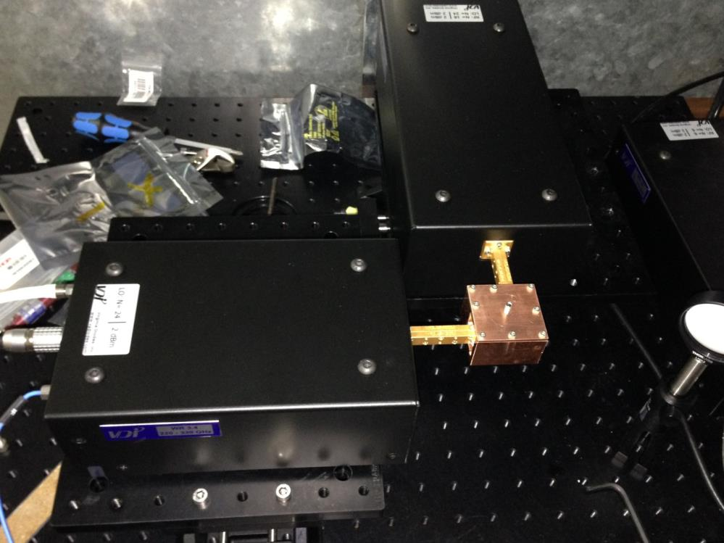
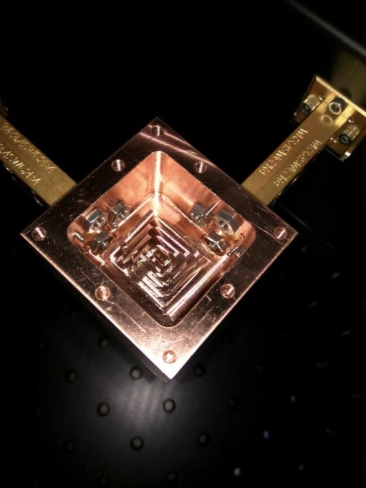
Scaled Enclosure Direct Injection Measurement
Scaled
Enclosure
(s = 40)
mm-wave
extender
mm-wave
extender
3 cm

Slide 23
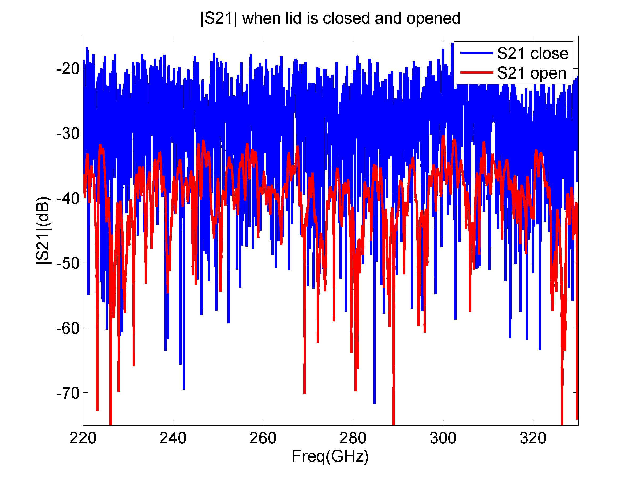
Transmission Through s = 40 Cavity
|S₂₁| (dB)
Frequency (GHz)

Slide 24
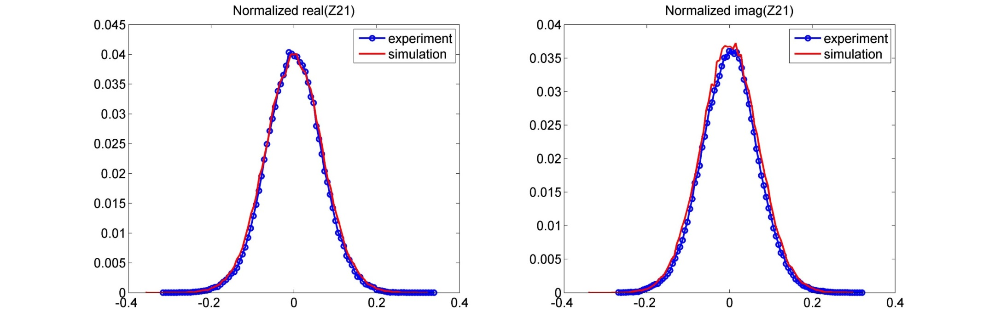
First Ensemble Averaged Statistics
(s = 40) Scaled Enclosure (220 – 330 GHz)
9 Realizations
Normalized with Z_{avg}
Room temperature
Best fits to RMT with α = 32.7

Slide 25
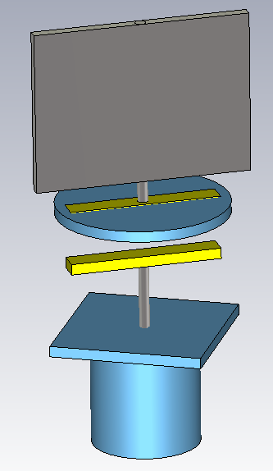

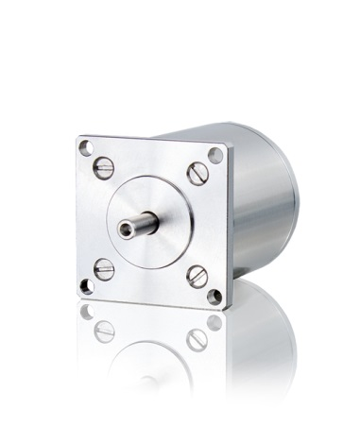
Cryogenic Mode Stirrer
Scaled enclosure wall
Use cryogenic stepper motor to rotate a magnetic strip below scaled cavity, causing the stirrer panel inside cavity to rotate.
No holes in the cavity walls (no leakage)
Stirrer
Bar Magnet
Cryogenic stepper motor

Slide 26
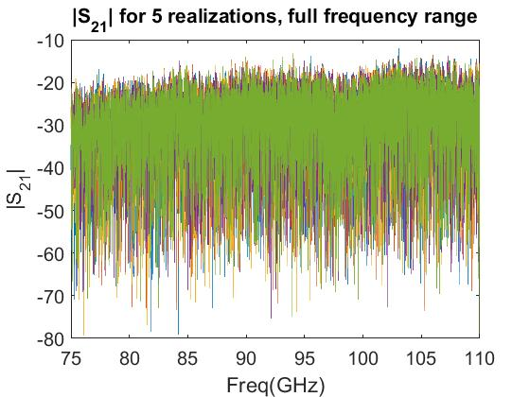
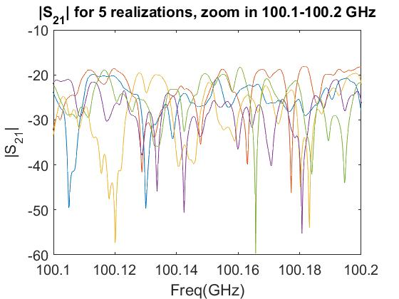
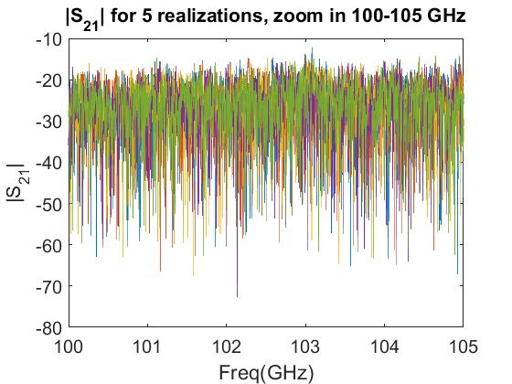
Multiple Realizations of s = 20 Scaled Enclosure at Cryogenic Temperatures

Slide 27
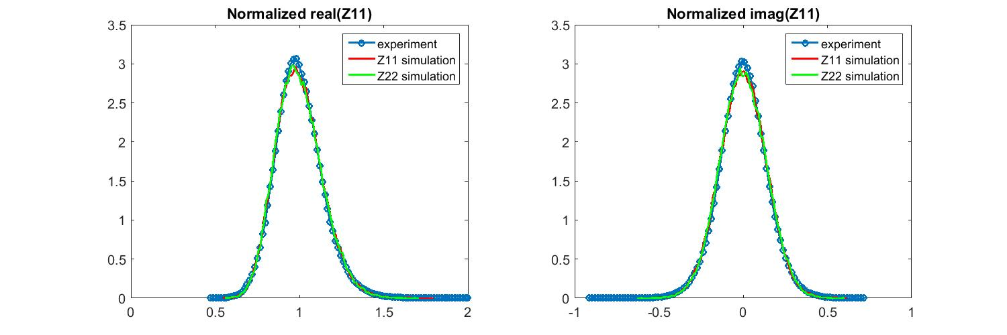
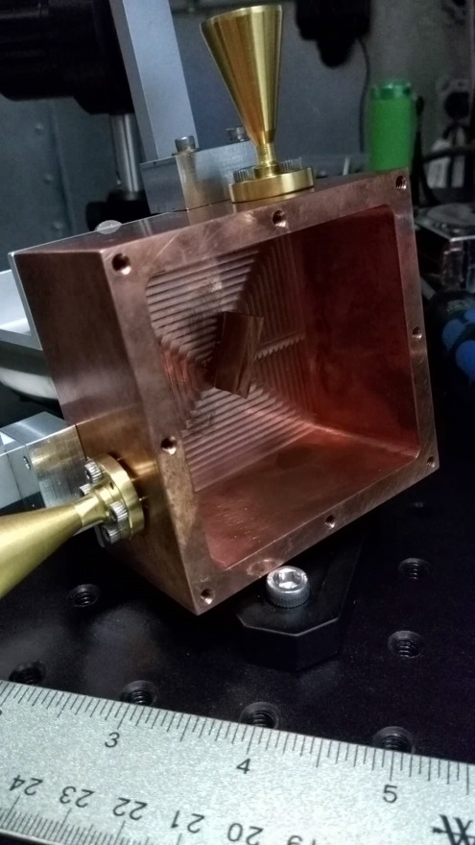
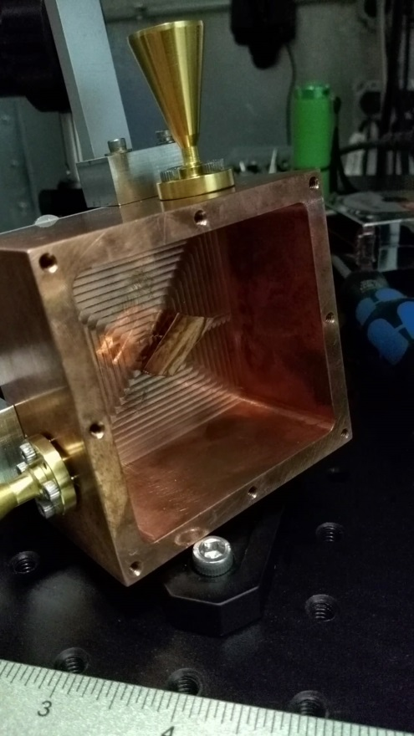
Cryogenic Results for the s = 20 Scaled Enclosure
Motion of the Perturber (Cu Sheet) Inside
the s = 20 Scaled Enclosure
α = 19
Rotating
Perturber
α = 19
Statistics with just
9 Realizations

Slide 28
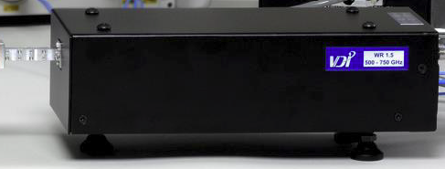
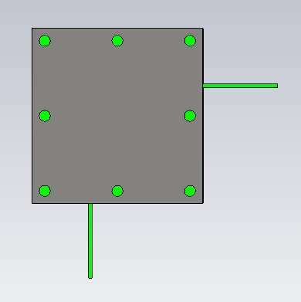
Top View of Scaled Enclosure Experiment
scaled
enclosure
mm-wave extender
lens
cryostat
Early Objectives:
Compare Z-statistics results to NRL GigaBox
Measure multiple coupled enclosures and
compare to Gradoni predictions
Aperture illumination of enclosures
Mixed system experiments
antenna

Slide 29
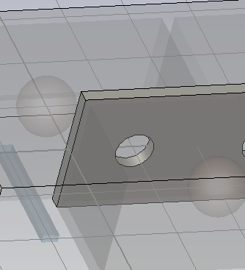
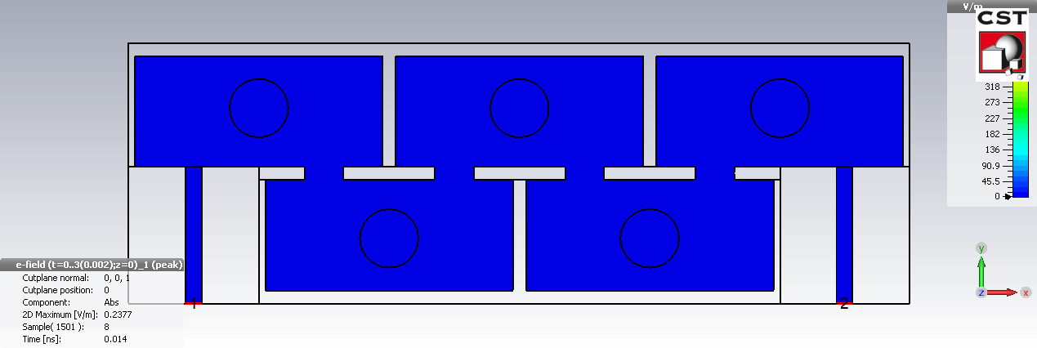
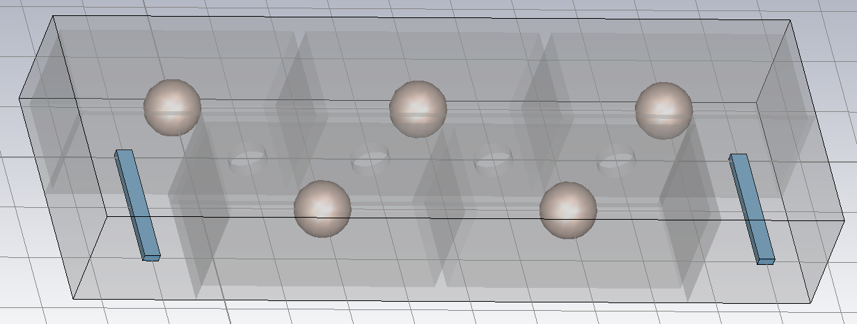
Coupled Cavities Simulation
Circular aperture
Dielectric sphere

Slide 30
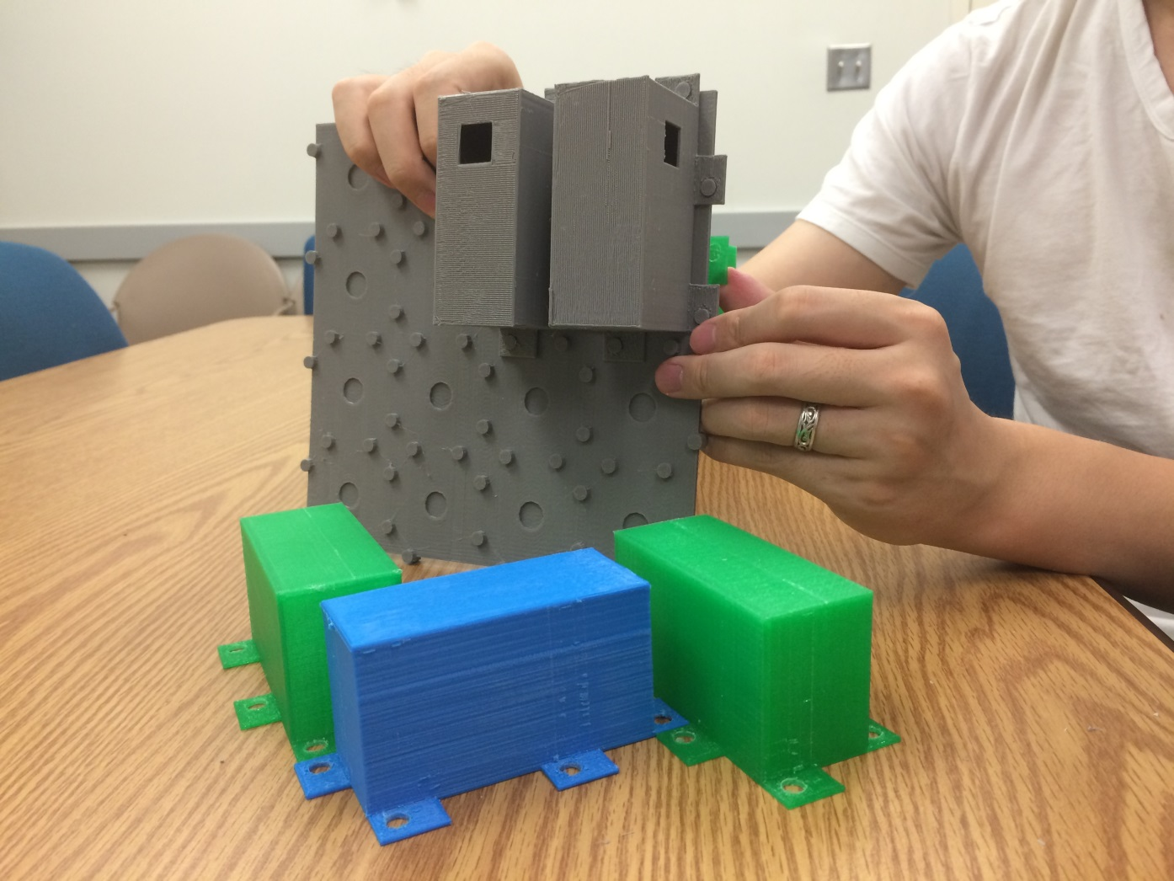
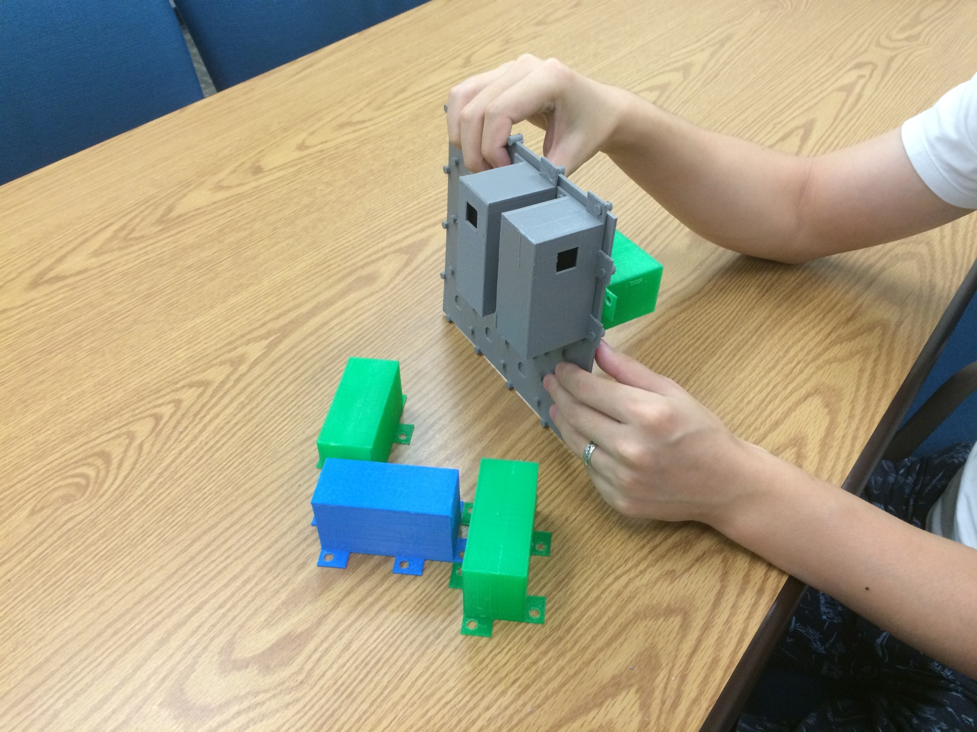
3D Printed Scaled Structures:
Multiple Connected Enclosures
Ports
Backplane
with Apertures
Scaled
Enclosures

Slide 31


Conclusions
The Random Coupling Model constitutes a comprehensive (statistical) description of the
wave properties of wave-chaotic systems in the short wavelength limit
We believe the RCM is of value to the EMC / EMI community for predicting the statistics
of induced voltages on objects in complex enclosures, for example.
A new measurement system employing scaled structures enables new extensions of RCM:
Multiple connected enclosures
Irradiation through irregular apertures
Systems with mixed (regular and chaotic) properties
Systems with evanescent coupling
anlage@umd.edu
http://anlage.umd.edu/RCM
Research funded by ONR
ONR/DURIP
AFOSR / AFRL Center of Excellence
RCM Review articles:
G. Gradoni, et al., Wave Motion 51, 606 (2014)
Z. Drikas, et al., IEEE Trans. EMC 56, 1480 (2014)

Slide 32

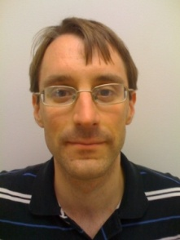
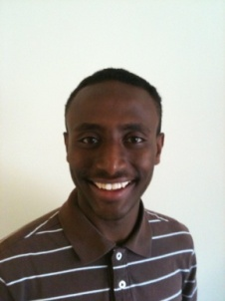





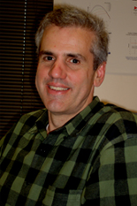
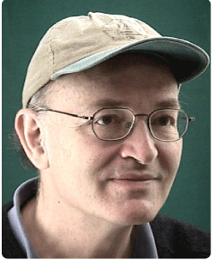
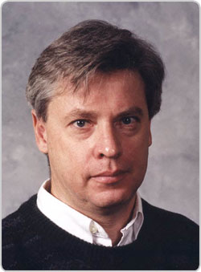
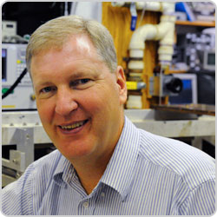
The Maryland Wave Chaos Group
Graduate Students (current + former)
Jen-Hao Yeh
LPS
James Hart
Lincoln Labs
Biniyam Taddese
FDA
Bo Xiao
Mark Herrera
Heron Systems
Ming-Jer Lee
World Bank
Trystan Koch
Bisrat Addissie
Faculty
Also:
Undergraduate Students
Eliot Bradshaw
John Abrahams
Gemstone Team TESLA
Post-Docs
Gabriele Gradoni
Mathew Frazier
John Rodgers
NRL, Naval Academy,
UMD
Ed Ott
Tom Antonsen
Steve Anlage
NRL Collaborators: Tim Andreadis, Lou Pecora, Hai Tran, Sun Hong, Zach Drikas, Jesus Gil Gil
Funding: ONR, AFOSR, DURIP

Slide 34
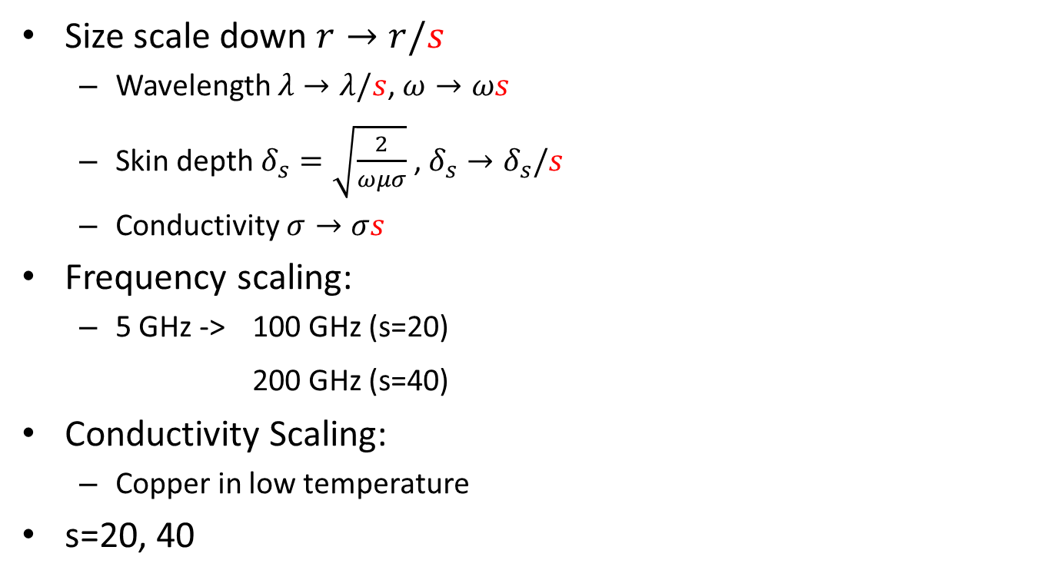
Scaling
Size scale down $r→r/s$
  Wavelength $λ→λ/s$, $ω→ωs$
  Skin depth $δ_{s}=\sqrt{\frac{2}{ωμσ}}$ , $δ_{s}→δ_{s}/s$
  Conductivity $σ→σs$
Frequency scaling:
  5 GHz -> 100 GHz (s=20)
200 GHz (s=40)
Conductivity Scaling:
  Copper in low temperature
s=20, 40

Slide 35
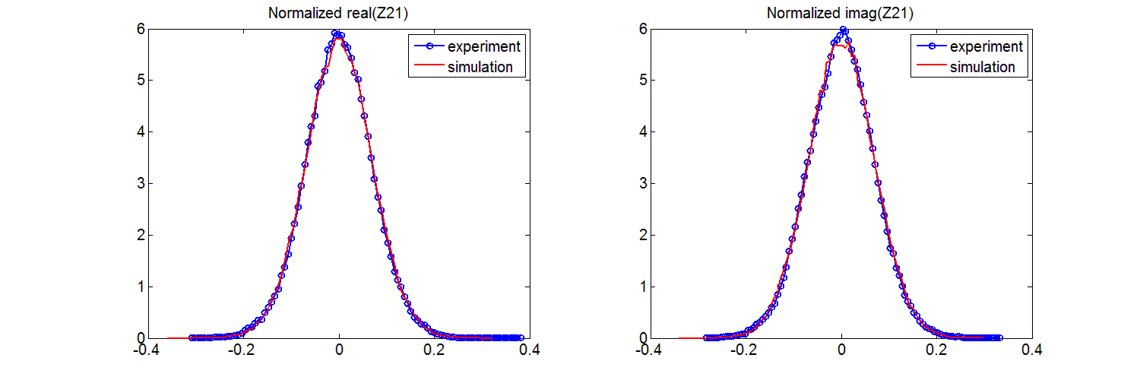
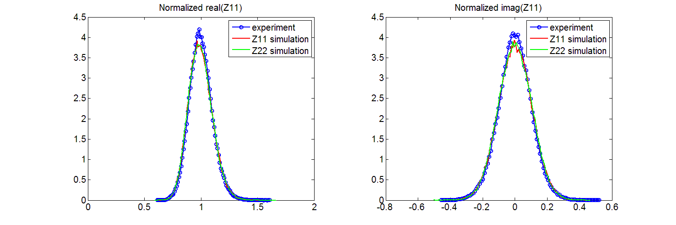





Normalized real(Z₂₁)
Normalized imag(Z₂₁)
PDF
PDF
$$Re[z_{21}]$$
$α≈32.7$
220 ~ 330 GHz
Im$[z_{21}]$
Normalized real(Z₁₁)
Normalized imag(Z₁₁)
PDF
PDF
$$Re[z_{11}]$$
Im$[z_{11}]$

Slide 36
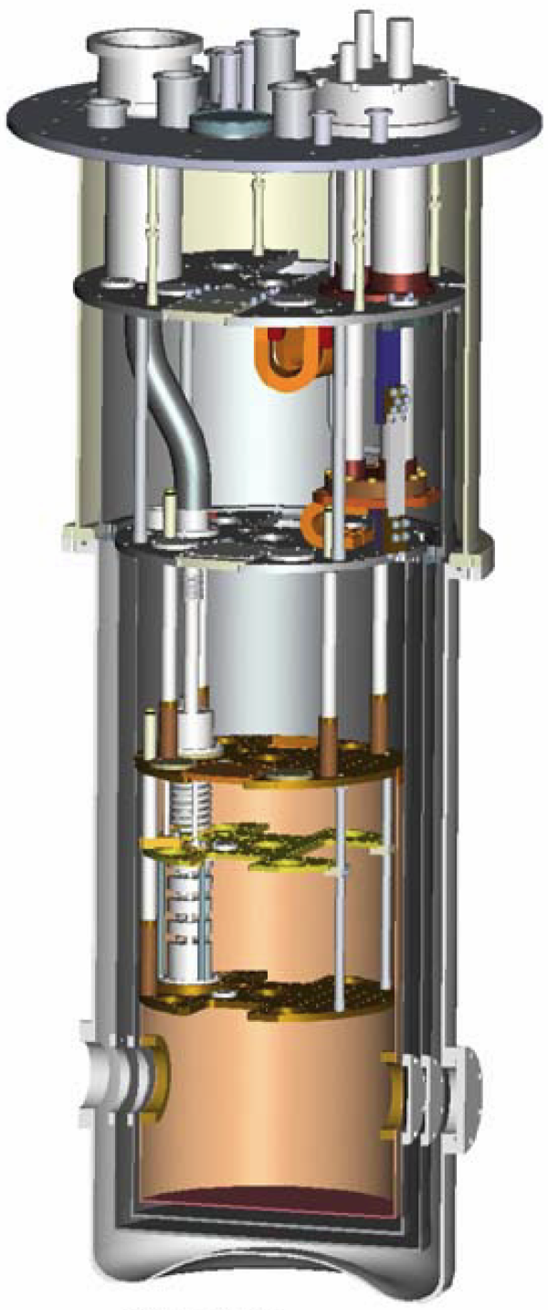
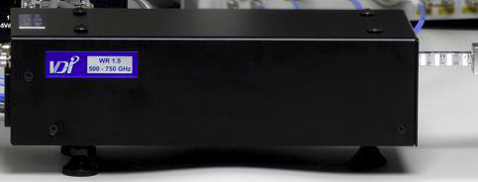
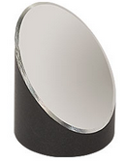
BlueFors Dry Dilution
Refrigerator, 50-cm-
diameter MXC plate
Keysight N5242A
4-port Vector Network
Analyzer
VDI mm-wave
extenders:
75 – 110 GHz;
110 – 220 GHz;
220 – 330 GHz
DUT

Slide 37

Untested Prediction #2 Induced Voltage Statistics for Irradiation Through an
Irregular Aperture
Treat both the aperture and the enclosure statistically
Relevant variables:
Loss in the enclosure
Scaling prediction involving size of aperture and enclosure losses
….

Slide 38

Wave Chaos?
1) Waves do not have trajectories
It makes no sense to talk about
“diverging trajectories” for waves
2) Linear wave systems can’t be chaotic
Maxwell’s equations, Schrödinger’s equation are linear
3) However in the semiclassical limit, you can think about rays
In the ray-limit
it is possible to define chaos
“ray chaos”
Wave Chaos concerns solutions of linear wave equations which,
in the semiclassical limit, can be described by chaotic ray trajectories

Slide 39



Transmission Through Cavity
Transmission ≈ -20 dB
Scaled copper cavity in room temperature$α≈32.7$
NRL full-scale experiment
  $$α≈6$$
$$α=\frac{1}{2πσ_{21}^{2}}=\frac{1}{πσ_{11}^{2}}$$
  P_{in} = 1 W
  Z_{load} = 50 Ω
Next step: Cool the scaled cavity to
reduce α to that seen in the NRL experiment

Slide 40
Untested Prediction #4 Statistics of tunneling (coupling)
between enclosures through apertures that are below cutoff
Fluctuations in the transfer (tunneling) rate are stronger for regular vs. chaotic enclosures
Relevant variables:
Do regular enclosures show stronger coupling? Should we make enclosure ray-chaotic?
We need reasonably-sized waveguides that are below cutoff
….

